Slide 1
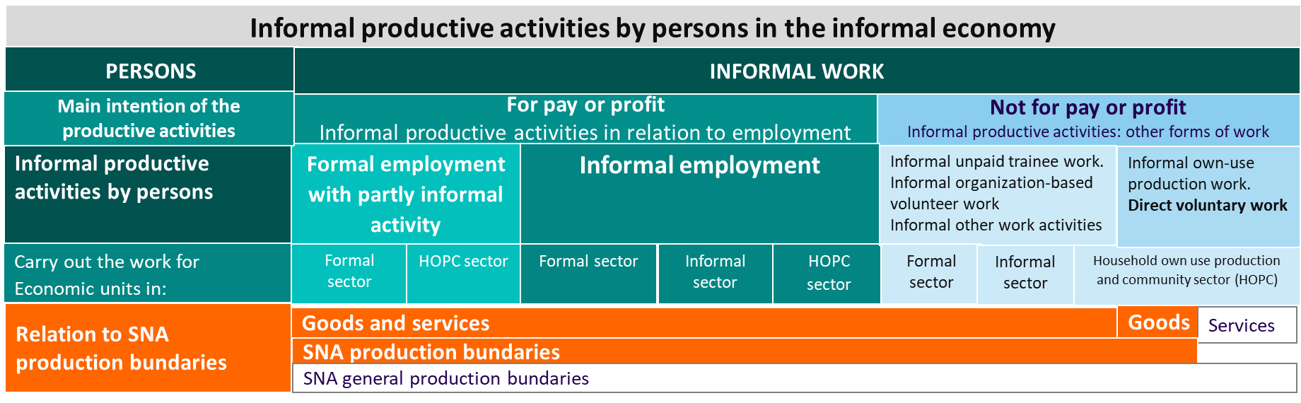
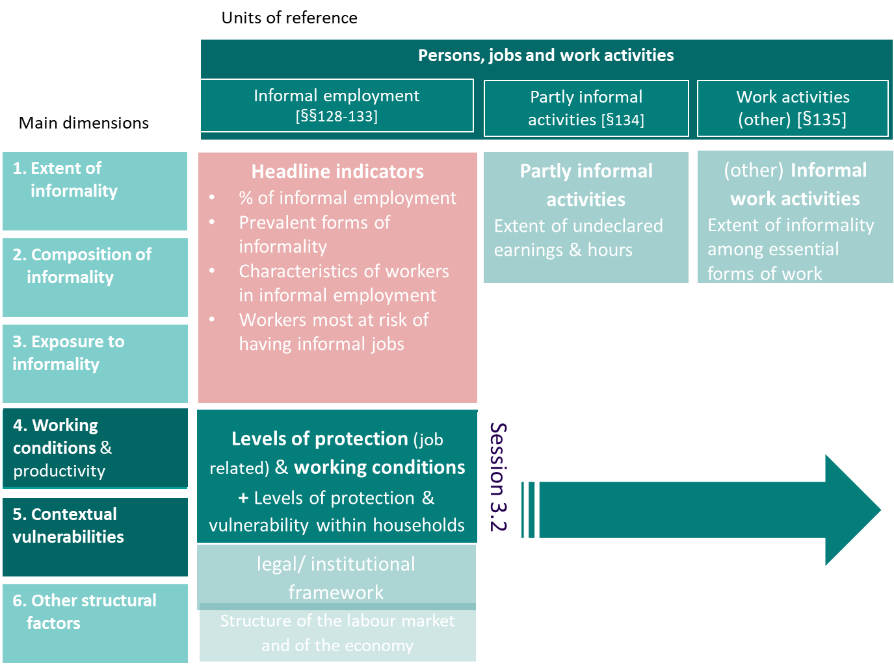
Conceptual framework
Session 3.2
Informality, levels of protection, working conditions and contextual vulnerabilities: are decent work deficits more critical in the informal economy and are households a source of increased vulnerabilities or protection?
Indicator framework
Regional Course on Statistics on Informality:
Definitions, Measurement, SDGs and Other Policy Indicators
15-18 October 2024, Chiba, Japan
Florence Bonnet AP/FORMALIZATION (bonnet@ilo.org)

Slide 2
Scope of the session
    Focus
    in the conceptual framework of the informal economy, focus on persons/ jobs and work activities and assess:
      Whether decent work deficits are more pronounced among workers in informal employment compared to those in formal employment
      Whether formal jobs are decent jobs
      To what levels of protections do workers in informal employment/work benefit in relation to
        their job or work activity
        taking into consideration the household dimension, namely “contextual vulnerabilities”
    Those indicators contribute to position workers (and economic units ) along the scale of ‘protection/ vulnerabilities’ Contribute to the identification of some of the drivers of informality
    Sources:
      As far as working conditions and levels of protection or vulnerability associated to jobs are concerned most (if not all) of the indicators can be produced from a typical labour force survey
      For the assessment of vulnerabilities and protections within household and beyond the world of work: household income and expenditure surveys (or similar surveys)
    Frequency: Countries are encouraged to produce those indicators with a regular frequency depending on needs and priorities and feasibility
*
* Under dimension 4 (Working conditions and productivity), the indicator framework on the informal economy also recommends a set of indicators related to the performance and productivity of economic units and, in particular, on factors that affect them
*

Slide 3
Scope: Working conditions and levels of protection
Informal employment
4. Levels of protection and working conditions for those in informal versus formal employment
Main dimensions
1. Extent of informality
Objectives
  Identify/assess levels of protection and vulnerabilities associated to the person’s main job
  Assess working conditions or the extent of decent work deficits among persons having informal jobs or having formal jobs
2. Composition of informality
3. Exposure to informality
4. Working conditions & productivity
5. Contextual vulnerabilities
4. Working conditions & productivity
5. Contextual vulnerability
5. Contextual vulnerability
Objectives
  Complements the assessment at the individual level of personal and job-related features and vulnerabilities (dimension 4)
  A broader assessment at the household level of intra-household vulnerabilities and opportunities. It considers risks and factors beyond the world of work and beyond decent work deficits.
6. Other structural factors
Dimensions 4, 5

Slide 4

Formality/informality and levels of protection
Does formalization mean protection against personal & economic risks? Are formal jobs decent jobs?
  Working conditions among workers in formal employment
  Productivity & performance of formal economic units
  Assessing the adequacy of the level of protection
  Can contribute to the analysis of the risk of informalization
Formal jobs, productive activities
“Protection against personal and economic risks”: decent work

+
Transition to formality…
….incl. Preventing informalization
Level of protection against economic and personal risks
-
+
From what protections do workers in informal employment benefit?
Under Dimension 4. Working conditions & productivity:
  Income security; levels of protection; level & forms of organization / representation such as:
    Voluntary contribution to social security; contribution to social security for non-employees
    Access to paid sick and annual leave (but not to social security)
  Representation/organization
  Productivity of enterprises
  Under Dimension 5. Contextual vulnerabilities
  Broader assessment of income security: from all sources & from all household members, incl. broader assessment of social protection coverage — beyond job-related statutory contributory coverage

Most pronounced decent work deficits, low productivity
-
Informal jobs, productive activities

Slide 5

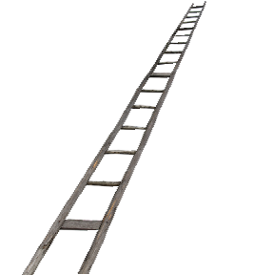

Transitioning to formality formalization and reduction of decent work deficits
The analysis of working conditions & productivity together with contextual vulnerabilities as part of the broader assessment of the ability of workers to formalize
Formalized jobs & enterprises
Strengthening the ability to comply is important
Strengthening the willingness to comply which is largely driven by the perception of fairness and the accountability of institutions is also essential
Importance of the institutional, legal and business environment
Importance of the capacity of the economy to create formal jobs
    Not everyone is in a position to be formalized in the short run and to remain formal.
Facilitate formalization: “coverage and compliance with formal arrangements
“ & link formalization to effective benefits
Productive unregistered enterprises
Continuum of situations in terms of levels of informality & lvulnerabilities but also opportunities for a sustainable formalization

Employees informally employed in formal enterprises
Factors/pre conditions to consider:
For employees: to be in the informal sector; the absence of recognition of the employment relationship;
For all: being excluded from the scope of labour, social & fiscal laws
Create the conditions for future formalization
Improve working conditions, strengthen capacities, productivity, secure income
Reducing decent work deficits
Reducing vulnerabilities
High level of informality/vulnerabilities
Critical decent work deficits
Poverty, irregular income; lack of capital, low level of education, low productivity
Subsistence activities, casual workers many low-educated own-account workers, contributing family workers
Notes:
Key messages:
- Some are ready to formalize, other not
- In the latter case, need to create the conditions to formalize
Reducing DW deficits as condition for TTF - formalization is a gradual process and cannot be achieved for everyone in the short run.
Targeted refers to various possible approaches that apply to different contexts and different groups of workers towards which formalization responses need to be adapted to.
The transversal nature of the approach signifies that dealing with informality includes multiple policy dimensions. A strategy that only addresses a single dimension, for example detecting the non-compliance with labour regulations, is insufficient for achieving effective transitions from informality to formality

Slide 6
Indicators referring to persons/jobs and work activities
Working conditions

Slide 7
Assessing working conditions: the multiple dimensions of decent work
Main dimensions
  (Labour-) income security. This includes the level, regularity and predictability of income from labour, including job-related social protection. A broader assessment of income security, including poverty and the capacity to cover basic needs, is covered under dimension 5 (contextual vulnerabilities) to include income security from other sources (for example, non-labour-related income and non-job-related social protections) at both the individual and household levels.
  Place of wok. The type of place of work has obvious consequences, including:
  the visibility or invisibility of these enterprises and workers, whether in terms of the detection of informal practices or of identification for the provision of benefits, awareness-raising, organization and representation;
  the hazardous working conditions associated with certain types of place of work;
  the capacity to invest and productivity; and
  in some cases, possible legal limitations, as is the case for domestic workers in households that are considered to be part of the private sphere, who are therefore sometimes excluded from the scope of intervention of labour authorities.
  Notes
  The categories of place of work should follow the ones presented in paragraph 100 of the Resolution concerning statistics on work relationships
  Complemented by the assessment of social security and labour laws:
    Is there any eligibility conditions associated to the place of work
    Scope of labour and social security inspection
  Working time. Includes
  the comparison of the number of actual and usual hours of work between workers in informal and formal employment in order to identify whether workers in informal employment are more likely to work outside normal hours of work.
  Assessing the possible differences between workers operating in the informal economy and other workers in terms of working-time arrangements, including the incidence of work during weekends or night work
  the assessment of time spent on own-use production of goods and services, in particular unpaid domestic and care work
  The assessment of working time:
  contributes to assessing the relative level of exposure to risks such as health and safety, in-work poverty and work–life balance issues
  should be complemented by the assessment of social security and labour laws to identify eligibility criteria based on a minimum number of hours to be eligible for benefits/ coverage (some categories particularly affected: mini jobs, domestic workers)
  Importance of the gender dimension
  Representation security is about assessing:
  the level & forms of organization of workers & economic units of the informal economy (compared to the formal)
  the links between employers' and workers' organizations and informal economy organizations
  the knowledge, perceptions and expectations of actors in the informal economy in relation to employers' and workers' organizations
  the situation of employees, self-employed workers = > different needs
  Note
    in LFS the question about trade unions, usually asked to employees
    In enterprise surveys may find other forms of representation and associations
    Could be of interest to assess what could be the role of workers and employers’ organizations in the formalization process; current services and expectations from members, obstacles, etc => may call for specific surveys and more qualitative assessments
4.1. (Labour-) income security
  Health and safety covers issues such as :
  Exposure to hazardous conditions of work for respectively workers in formal and informal employment or in formal sector and informal sector units (by sex, status in employment, sectors, occupations)
  Use of preventive equipment
  Incidence of occupational injuries and diseases
  Protection: access to healthcare and financial compensation in case of injury (health and employment injury insurance)
  Issues to consider:
    assess whether labour force survey data provide reliable data (especially among workers in informal employment) to support the development of sound indicators
    should take into account differences according to sectors and the usual place of work
    Legal information on the existence of employment injury benefits and eligibility conditions
4.1. (Labour-) income security
4. Working conditions
4.2. Employment security
  Employment security. Employment security refers to different realities, based on status in employment. For employees, it can include the existence and type (and when relevant, the duration) of the employment agreement. The meaning for other employment statuses (independent workers, dependent contractors and contributing family workers) is less clear.
  Note
  to be complemented by the assessment of social security and labour laws:
    Is there a need to adjust the legislation to promote the effective recognition of the employment relationship?
    Are the same levels of protection attached to temporary contracts compared to permanent contracts?
4.2. Employment security
4.3. Place of work
4.3. Place of work
4.4. Working time
4.4. Working time
4.5. Representation security
4.5. Representation security
4.6. Health and Safety
4.6. Health and Safety
  Skills security is about skill enhancement. It complements the analysis of levels of education to considers opportunities for training & re-training and apprenticeship to acquire and refine knowledge and competencies.
4.7. Skills security
4.7. Skills security

Slide 8
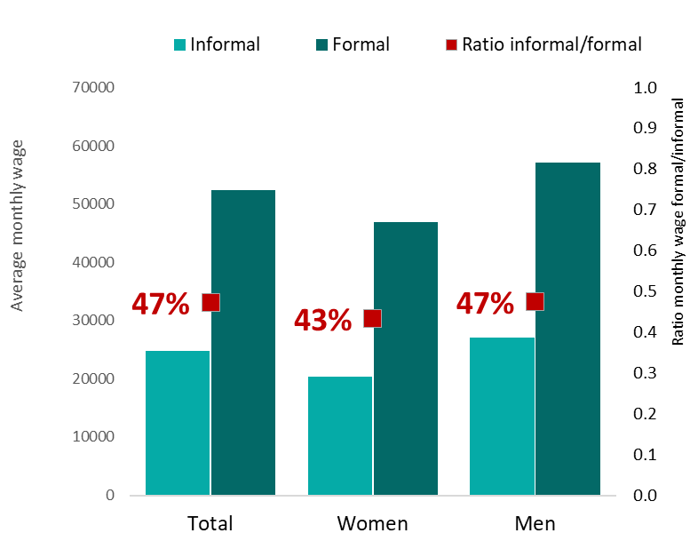
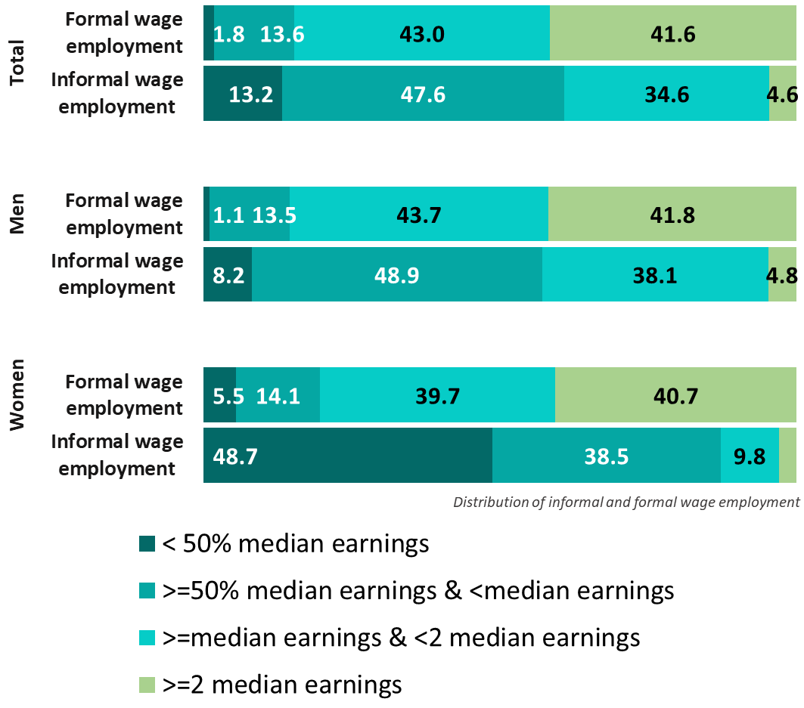

Informal employment
D. Working conditions: Labour income security
Para. 130b
India. Monthly average employment income among employees (informal compared to formal) by sex (2023, national currency)
Pakistan. Distribution of employees in formal and informal wage employment depending on their levels of earnings (compared to median wage) by sex (LFS2021, %)
    Labour income security
          level, regularity, predictability of income, type of remuneration (e.g. daily, weekly, monthly, piece-rate)
          To be complemented with a comprehensive assessment of income security (all sources of income; household perspective, including poverty)
4.1. (Labour-) income security
4.1. (Labour-) income security
4. Working conditions
4.2. Employment security
4.3. Place of work
4.4. Working time
    Indicators included in the resolution
130b(i).Monthly and hourly average employment income among workers with informal main jobs and formal main jobs, by status in employment
4.5. Representation security
4.6. Health and Safety
For specific country data, see indicators 20-22 (working conditions) in country profiles
4.7. Skills security
130b(ii). Percentage of persons with informal main jobs and formal main jobs earning less than the defined benchmarks (for example, the minimum wage or 50 per cent of the median wage), by status in employment
130b.i
130b.ii

Slide 9
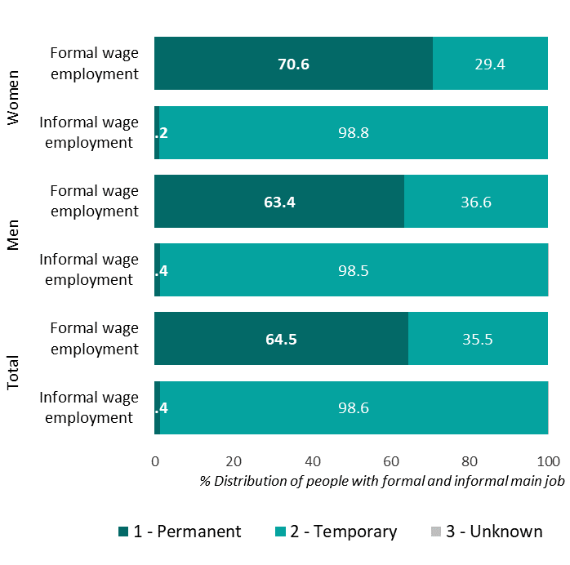
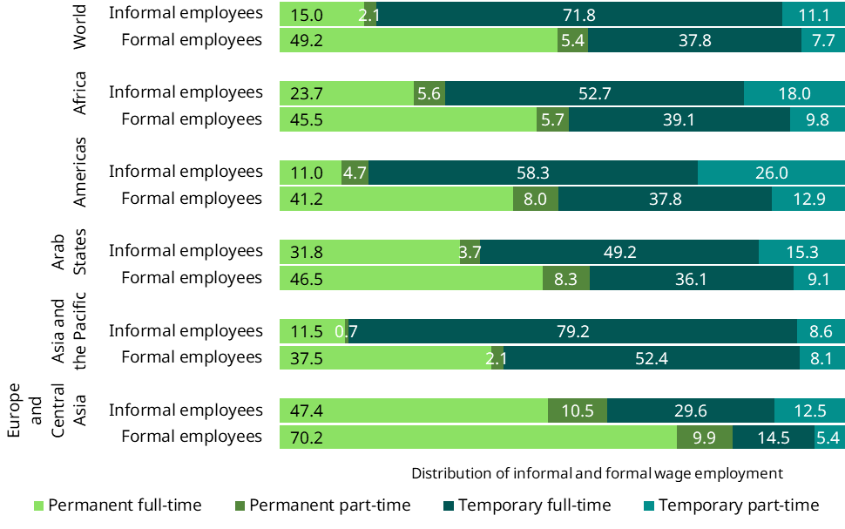
Informal employment
D. Working conditions: Employment security
Para. 130b
Pakistan. Distribution of employees with informal and formal main jobs, by type of employment agreement (%, LFS 2021)
    Employment security
          Note: interpretation can benefit from joint analysis with legal information to identify any exclusion from social protection or labour protection based on the type and duration of employment contracts
Global. Distribution of employees with informal and formal main jobs, by type and duration of employment agreement (% 2019)
4.1. (Labour-) income security
4. Working conditions
4.2. Employment security
4.2. Employment security
4.3. Place of work
4.4. Working time
4.5. Representation security
For specific country data, see indicator 23 (working conditions) in country profiles
4.6. Health and Safety
    Indicators included in the resolution
130b(iii). Distribution of employees with informal and formal main jobs, by type and duration of employment agreement
4.7. Skills security
130b.iii

Slide 10
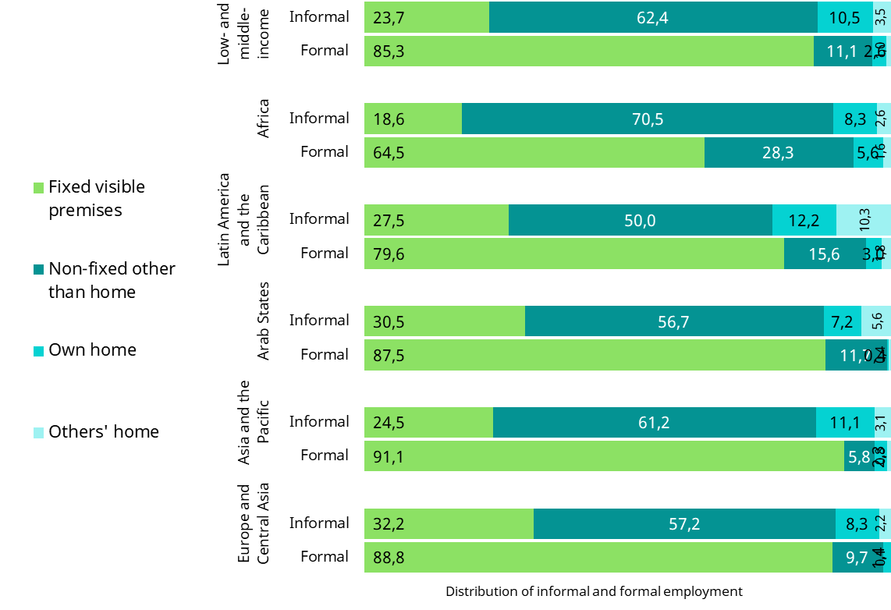
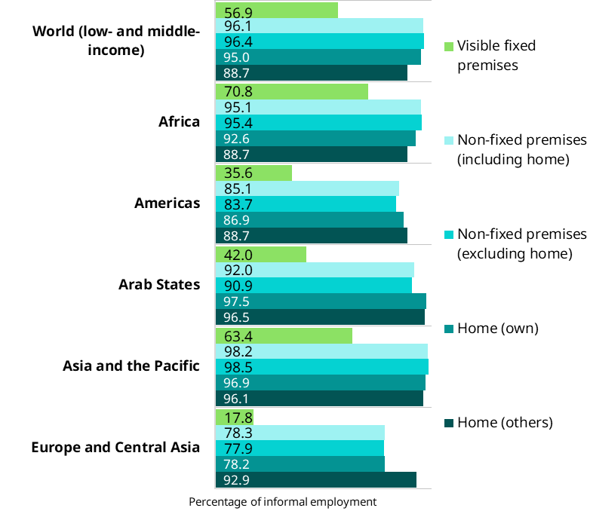
D. Working conditions: Place of work
Informal employment
Para. 130b
Where do people in informal and formal employment work?
Distribution of formal & informal employment by place of work
    Place of work
          Also part of the disaggregation: employment related features
          Allow the identification of home-based workers
          Contribute to the identification of domestic workers (beyond ISIC), and street vendors
4.1. (Labour-) income security
Share of informal employment depending on the place of the work (%, 2019) / low- and middle-income countries
For specific country data, see indicators 9 & 18 (working conditions) in country profiles
4. Working conditions
4.2. Employment security
4.3. Place of work
4.3. Place of work
Asia and the Pacific (low- & middle-income countries)
While over 85% of workers in formal employment work in fixed-visible premises, only one fourth of informal workers do so.
4.4. Working time
    Indicators included in the resolution
130b(iv). Distribution of persons with informal and formal main jobs, by place of work and status in employment
4.5. Representation security
Asia and the Pacific (low- & middle-income countries)
Informality is 1.5 times higher in non-fixed premises compared to fixed visible premises such as offices or factories.
4.6. Health and Safety
Complemented with the assessment of exposure to informality (dimension 3)
Incidence of informal employment by place of work
4.7. Skills security
130b.iv

Slide 11
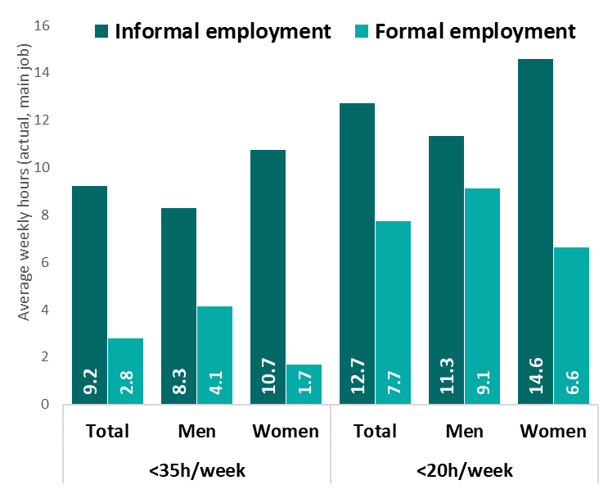
D. Working conditions: Working time (1)
Informal employment
Para. 130b
For specific country data, see indicators 26-30 (working conditions) in country profiles + next slide
    Working time
          Issues: Nber of hours; Working time arrangements; Time related under-employment
          Complementing time spent in employment (for pay or profit) with time spent on work activities other than employment
          Critical gender dimension
4.1. (Labour-) income security
4. Working conditions
4.2. Employment security
4.3. Place of work
130b(vii). India Time-related under-employment among workers working less than 35h/wk or 20h/wk (LFS2023)
4.4. Working time
4.4. Working time
    Indicators included in the resolution
130b(v). Distribution of persons with informal and formal main jobs, by actual hours worked (hour bands) per week, by employment status
4.5. Representation security
Keep it for next slide!
4.6. Health and Safety
130b(vi). Average number of actual hours of work per week, by persons with informal and formal main jobs and by status in employment.
4.7. Skills security
130b(vii). Time-related under-employment among workers working less than a set number of hours with informal and formal main jobs, by status in employment.
130b.v
130b.vi
130b.vii

Slide 12
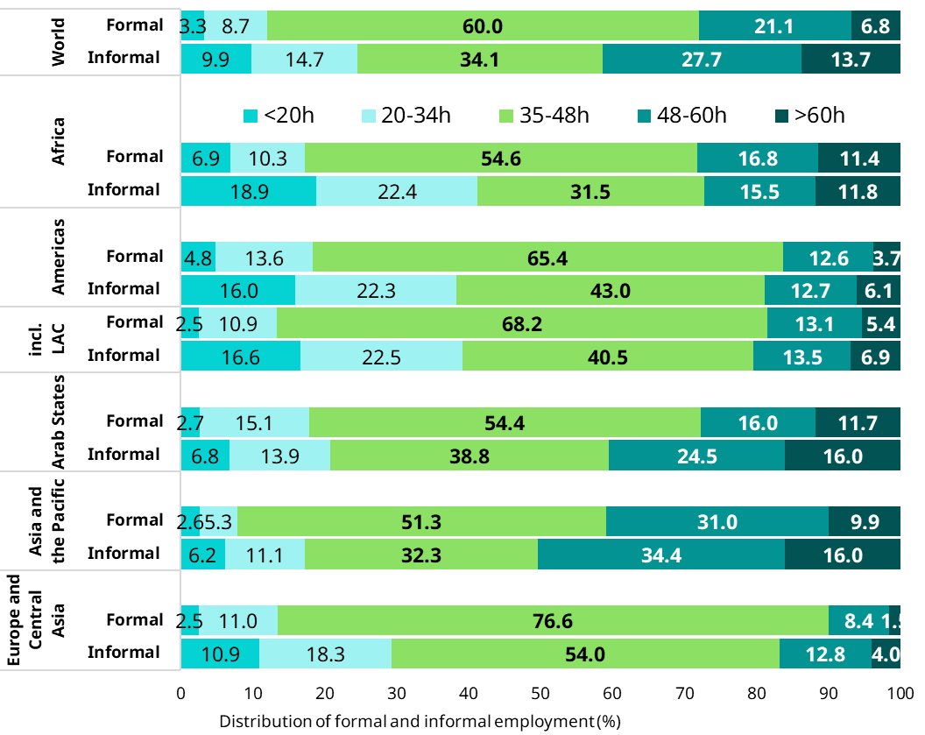
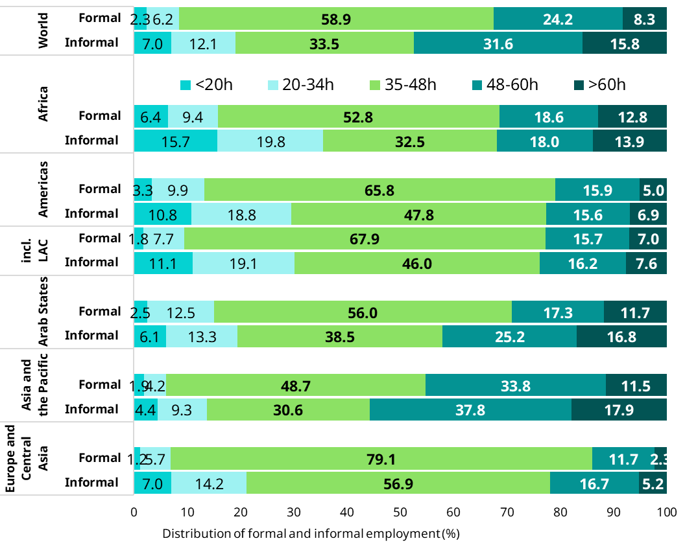
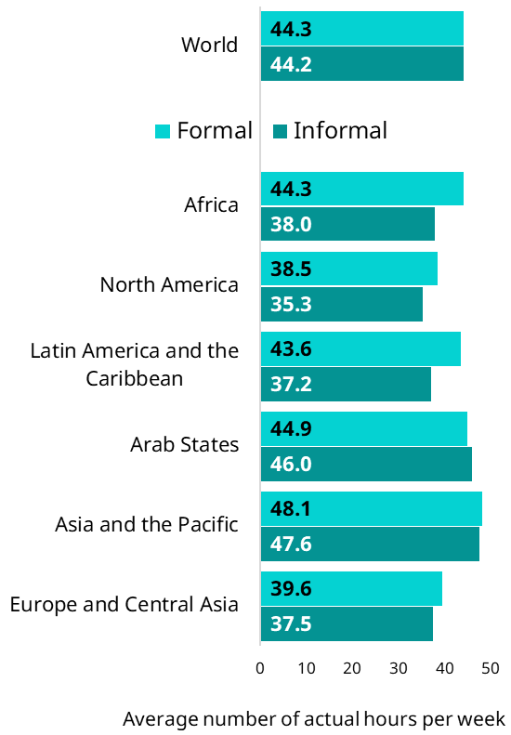
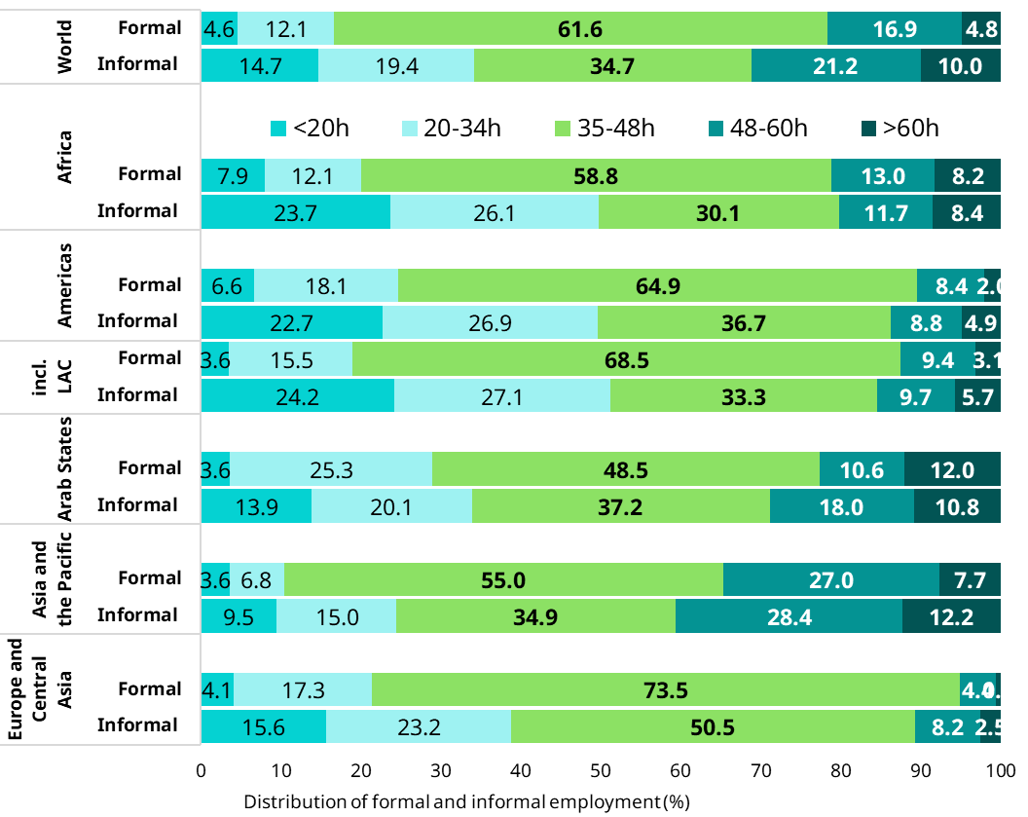
D. Working conditions: Working time (2)
Informal employment
Para. 130b
    Why do we need more than the assessment of the average number of hours?
4.1. (Labour-) income security
Global. Distribution of persons with informal and formal main jobs, by actual hours worked (hour bands) per week (% 2019)
4. Working conditions
Global | Average number of actual hours of work per week, by persons with informal and formal employment (hours/week, 2019)
4.2. Employment security
4.3. Place of work
4.4. Working time
4.4. Working time
4.5. Representation security
4.6. Health and Safety
Men
Women
4.7. Skills security
Total
130b.v
130b.vi
130b.v

Slide 13
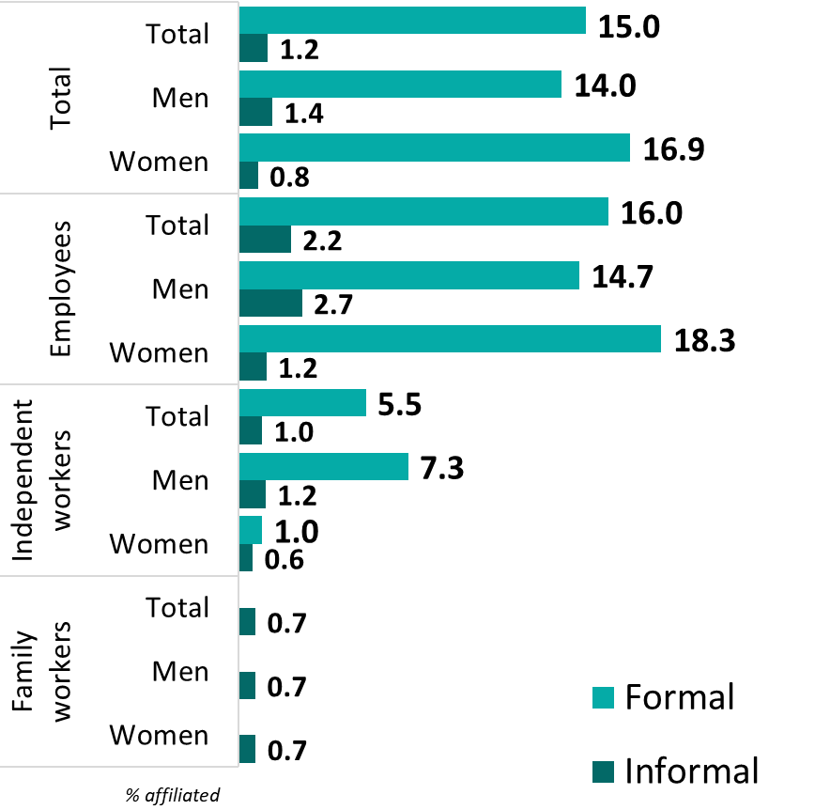
Informal employment
D. Working conditions: Representation
Para. 130b
    Representation security
          Issues: level of affiliation, forms of organization
          Important to assess various forms of member-based organizations and to cover all status in employment
Fiji. Percentage of persons with informal and formal main jobs affiliated to a union, a professional organization, a workers’ association or a member-based organization of worker – Employees (% EUS 2016)
4.1. (Labour-) income security
4. Working conditions
4.2. Employment security
4.3. Place of work
4.4. Working time
    Indicators included in the resolution
130b(viii). Percentage of persons with informal and formal main jobs affiliated to a union, a professional organization, a workers’ association or a member-based organization of workers, by status in employment.
4.5. Representation security
4.5. Representation security
4.6. Health and Safety
4.7. Skills security
130b(ix). Percentage of employees with informal and formal main jobs covered by one or more collective agreements
130b.v
130b viii

Slide 14
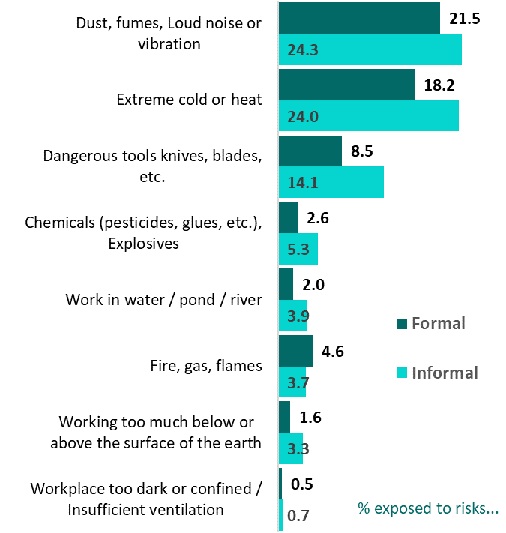
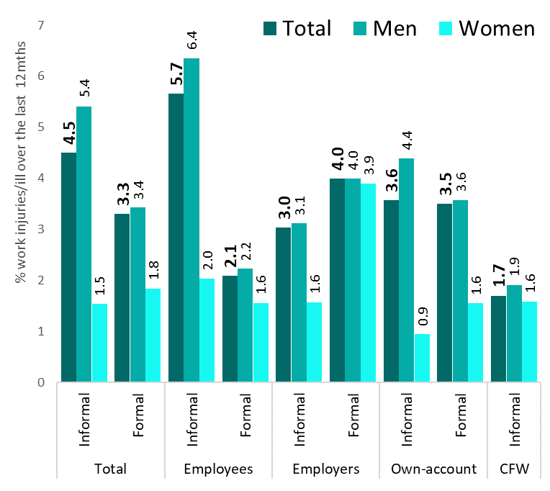
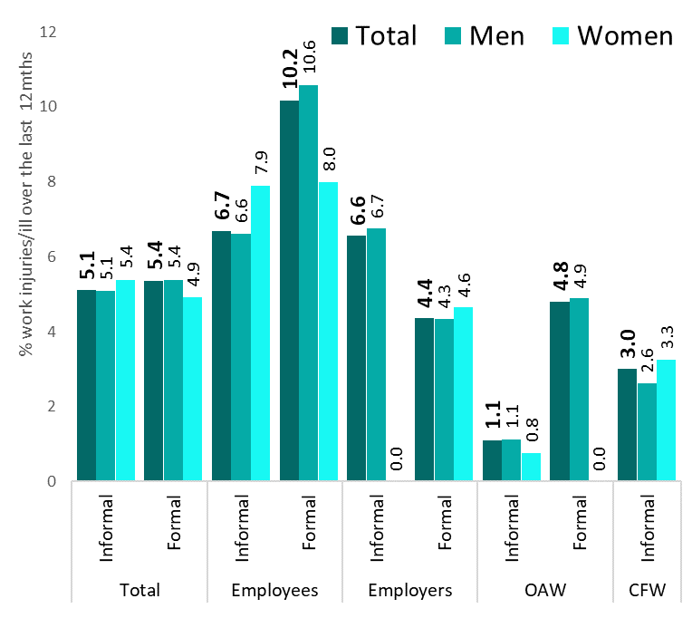
D. Working conditions: Health and safety
Bangladesh. During the last 12 months have you been exposed to any of the following hazards at work? (% LFS 2022)
Bangladesh. In the last 12 months have you been hurt in any accident while working that caused you injury or illness? (% LFS 2022)
Bangladesh. In the last 12 months, got any compensation from your workplace due to injuries?? (% of those that were injured, LFS 2022)
4.1. (Labour-) income security
4. Working conditions
4.2. Employment security
4.3. Place of work
4.4. Working time
4.5. Representation security
4.6. Health and Safety
4.6. Health and Safety
4.7. Skills security

Slide 15
D. Working conditions: Access to training & retraining and type of training
4.1. (Labour-) income security
4. Working conditions
Armenia (LFS, 2018)
4.2. Employment security
Côte d’Ivoire (ERI-ESI 2017)
4.3. Place of work
4.4. Working time
4.5. Representation security
4.6. Health and Safety
4.7. Skills security
Burkina Faso (ERI-ESI 2018)
4.7. Skills security

Slide 16
Indicators referring to persons/jobs and work activities
Levels of protections

Slide 17
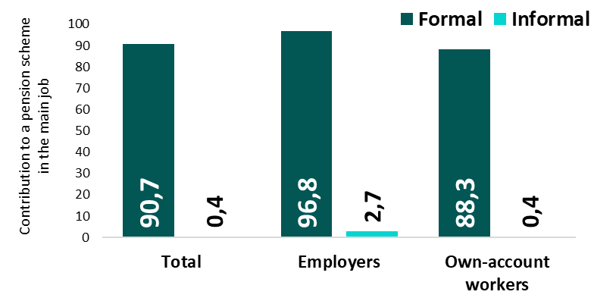
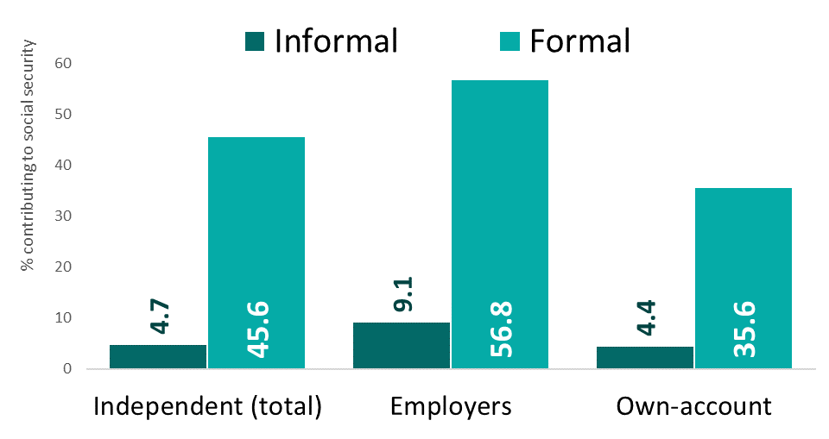
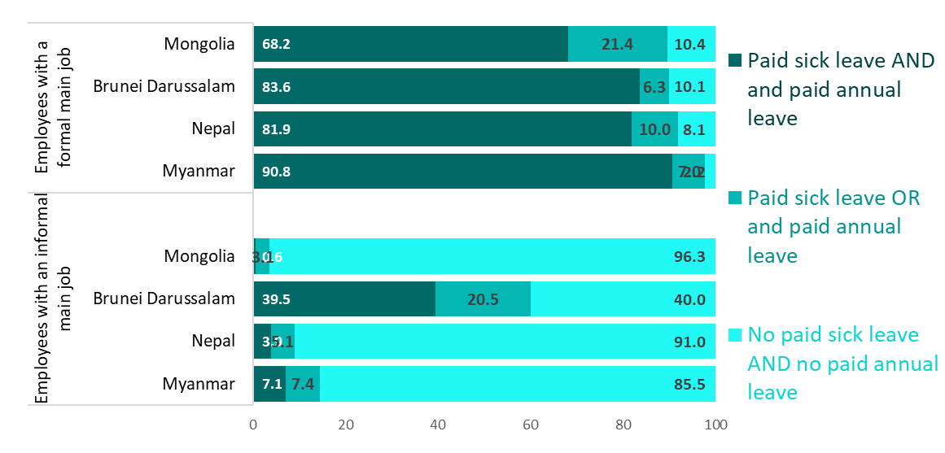
Reference unit: Jobs | Levels of protection
Informal employment
Para. 130a
Jamaica | Percentage of independent workers, respectively, with an informal or a formal main job, who contribute on a voluntary or mandatory basis to job-related statutory social security insurance (LFS 2022)
Uruguay | Percentage of independent workers, respectively, with an informal or a formal main job, who contribute on a voluntary or mandatory basis to job-related statutory social security insurance (ECH 2019)
4. Levels of protection and working conditions for those in informal versus formal employment
Main dimensions
Objectives
  Identify/assess levels of protection and vulnerabilities associated to the person’s main job
  To be complemented by other sources of vulnerabilities (e.g. Contextual vulnerabilities)
1. Extent of informality
2. Composition of informality
3. Exposure to informality
4. Working conditions & productivity
Indicators
  130a) Levels of protection among workers with informal and formal main jobs:
    (i) independent workers, (ii) contributing family workers and iii) dependent contractors contributing on a voluntary or mandatory basis to job-related statutory social security;
Selected countries | Percentage of employees with formal & informal main jobs with effective access to employment benefits (%)
5. Contextual vulnerability
6. Other structural factors
    Effective access of employees with (iv) a formal main job and (v) an informal main job to employment benefits (paid sick & annual leave)
Dimension D
130a

Slide 18
5. Contextual vulnerabilitites
Informal employment
Para. 133
Main dimensions
5. Contextual vulnerabilities
Objectives
  Complements the assessment of levels of vulnerabilities and levels of protection (under Dimension 4)
  Contextual vulnerabilities include two main blocks of indicators:
    indicators that refer to the household dimension and
    indicators that refer to the scope of the legal and regulatory framework (covered in the next session)
      Legal indicators: e.g., legal social protection coverage
      Identification of the source of informality: legal/ implementation
  Contributes to the assessment of the “readiness” to formalize
1. Extent of informality
2. Composition of informality
3. Exposure to informality
4. Working conditions & productivity
5. Contextual vulnerability
5. Contextual vulnerability
6. Other structural factors
Dimension E

Slide 19
Dimension 5. Contextual vulnerabilities
The household dimension
  The Household dimension aims to assess notably:
    Vulnerabilities associated with the composition of households regarding their employment situation:
      The levels of informality within households: fully/ partially/ not informal households
      The number/proportion of financial dependants considering labour income earners / economically dependent household members
    Income security at the household level:
      Income from all sources (individual and household levels / labour, social protection, assets, etc.);
      level of income poverty and income insecurity among informal workers
      composition of income and expenditure, and the ability to meet basic needs
    Social protection at the household level : non-job-related individual social protection
      Indirect coverage by contributory schemes through other household members
      Non-contributory social protection, including household-based benefits
      Social health financial protection (directly or indirectly through other household members).
Main dimensions
1. Extent of informality
2. Composition of informality
3. Exposure to informality
4. Working conditions & productivity
5. Contextual vulnerability
5. Contextual vulnerability
6. Other structural factors

Slide 20
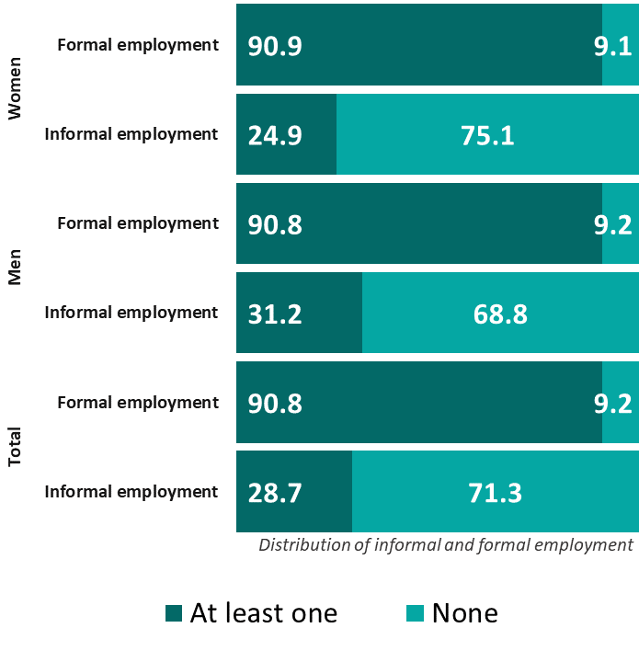
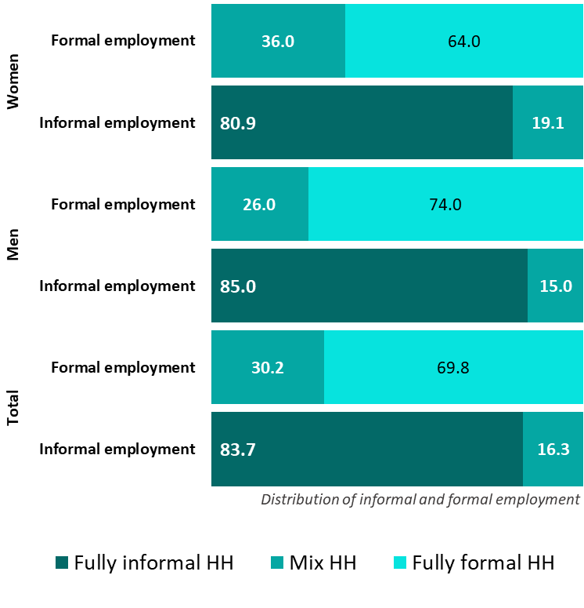
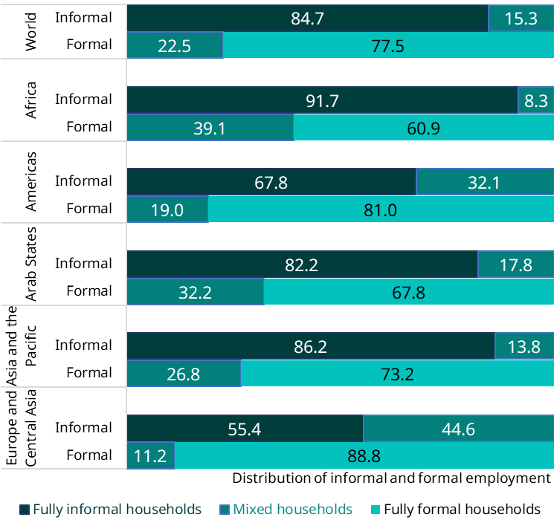
E. Contextual vulnerabilitites
Informal employment
Para. 133
E. Contextual vulnerabilities
Global and regional | 133a. Percentage of persons with informal main jobs who are living in households with at least one household member in formal employment by sex (%, 2019)
India| 133a. Percentage of persons with informal main jobs living in households with at least one household member in formal employment by sex (LFS, 2023)
Mongolia | 133b. Percentage of persons with informal main jobs living in households with at least one household member contributing to social by sex (LFS, 2023)
Main dimensions
Indicators included in the resolution:
  Based on LFS:
  133a. Percentage of persons with informal main jobs who are living in households with at least one household member in formal employment.
1. Extent of informality
2. Composition of informality
3. Exposure to informality
  133b. Percentage of persons with informal main jobs who are living in households with at least one household member contributing to social security.
4. Working conditions & productivity
5. Contextual vulnerability
5. Contextual vulnerability
For specific country data, see indicators 27-28 (contextual vulnerabilities) in country profiles
6. Other structural factors
133b
133a

Slide 21
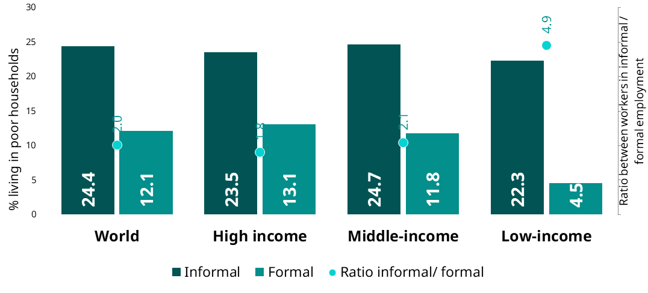
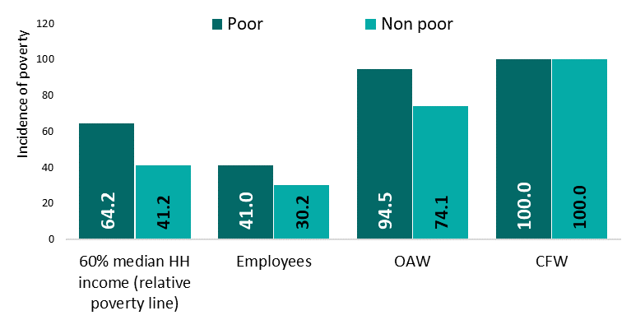
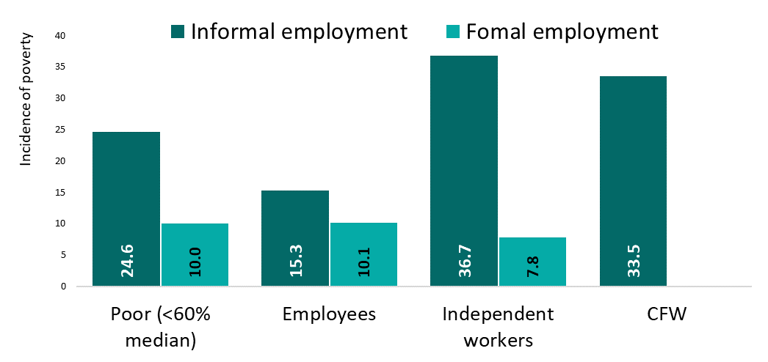
E. Contextual vulnerabilitites
Informal employment
Para. 133
Global | 133c. Percentage of persons respectively in informal and formal employment living in households below the relative poverty line of 60 per cent of median household income, by country income group (%, 2019 )
E. Contextual vulnerabilities
Main dimensions
Indicators included in the resolution:
  Based on HIES:
1. Extent of informality
2. Composition of informality
  133c. Percentage of persons with respectively informal and formal main jobs who are living in households below the national poverty threshold
3. Exposure to informality
4. Working conditions & productivity
  133d. Percentage of persons with informal main jobs, living in poor households and non-poor households
… Maldives (HIES 2019)| 133c.
… Maldives (HIES 2019)| 133d.
5. Contextual vulnerability
5. Contextual vulnerability
6. Other structural factors
Dimension E
133c
133d

Slide 22
Some useful elements for Abelina

Slide 23
Level of protection among workers in informal employment - Access to non-contributory social protection | Abelina
Percentage of workers in informal employment receiving some form of social protection
The social protection system in Abelina
The contributory system hardly reaches 40% of the employed
A set of non-contributory benefits are however available
  Some social assistance targeting older people aged 70+ and people with disabilities …
  Means-tested child benefits which is an household based benefit. Only the poorest households with at least 3 children are eligible
  Health insurance covers the main contributors and his/her dependents

Slide 24
Level of protection among workers in informal employment – The case of business owners (1)| Abelina
Distribution of enterprises by size of units
Business owners in Abelina
93,7% of informal sector units have no employee (LFS 2019)
Source of funding to start businesses:
  90% of informal business owners used their own savings or support from family/ friends (focus group discussion)
Independent workers: Coverage & compliance by formal arrangements
Coverage and compliance with formal arrangements among independent workers
  Only 8.4% of independent workers are registered with ABRA (Abelina Business Registration Agency)
  5.7% keep formal accounts in line with the legislation …. some may keep some simple (informal) accounts
  Large enterprises (50+) are all complying

Slide 25
Level of protection among workers in informal employment – The case of business owners (2) | Abelina
Business owners in Abelina
Awareness of formalization procedures & support services for enterprises
Some results from focus group discussions
Constraints
  Difficult access to market (high competition for the same type of product); difficult access to finances, inappropriate place of work (non-fix; unsafe)
  Low level of education, lack of access to equipment, non-fixed place of work contribute to the low level of productivity
Low level of awareness of regulations but also of support services to micro enterprises
Organization of informal entrepreneurs
  A significant proportion of entrepreneurs are members of professional organizations (30%)

Slide 26
The household perspective:
Example from Abelina
Abelina | Distribution of workers in formal / informal employment living in fully formal-semi-formal or fully informal households
What does this tell us?
66% of all workers in informal employment live in fully “informal-households” ….
34% live with workers in formal employment who:
  are covered by job-related social security (if employees) or maybe covered (if independent)
  Could potentially provide coverage indirectly to those in informal employment (as dependents)
  … or at least ensure a certain level of income security and predictability at the household level
-

Slide 27
Thank you !

Slide 28
Dimension 4. Productivity and economic performance of economic units
Observation
Main dimensions
Units economic and contribution to the economy
1. Size and trend of informality
7. The spatial
dimension
  (Labour?) Productivity by size (number of workers) of economic units and sector
  Factors enhancing/ constraining the development of eco. units and productivity:
      Labour related factors: composition of employment within the economic unit + working conditions (covered above);
      Production related factors:
        Access to property, place of work, …
        Access to finance: source of financing; indebtedness
        Access to machines or equipment; supply of raw materials
      Business environment factors: customers, suppliers and competitors, linkages between formal/informal sector
      Administrative factors
  Motivation: initial motivation to create the economic unit; motivation to formalize
  Past trends, prospects and needs
2. Composition of informality
3. Exposure to informality
?
4. Working conditions & productivity
5. Contextual vulnerabilities
6. Others factors structural

